Slide 1
Lecture 6 Label Aggregation Wrap-Up & Biases in Human-Generated Data
Chien-Ju (CJ) Ho

Slide 2
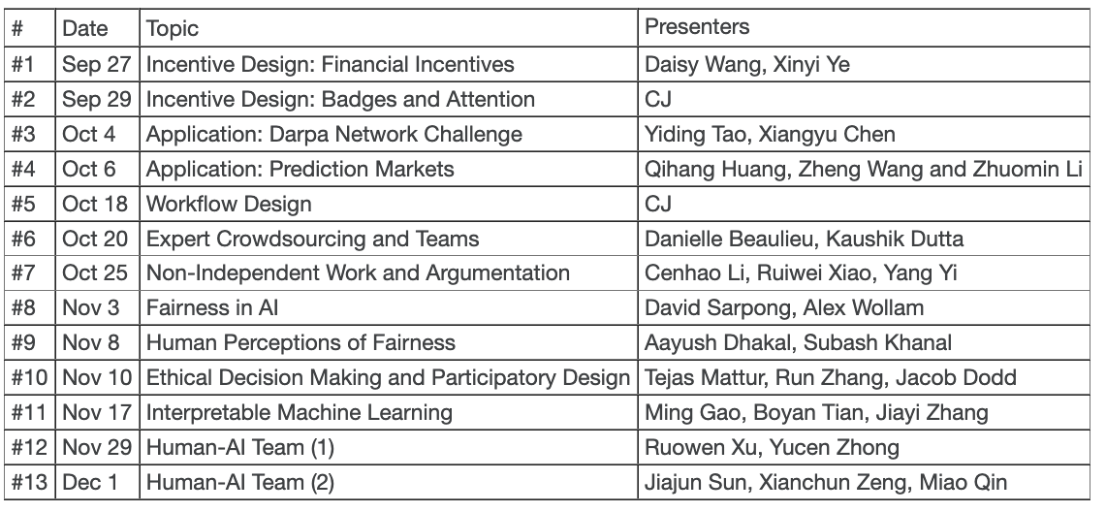
Logistics: Presentation

Slide 3
Logistics: Presentation
For presenters:
Give a 55~60 min presentation based on the required reading and at least two optional reading (3 optional readings for 3-person groups) of a lecture
The papers are the “backbone” of the presentation
Prepare 2 reading questions for the required reading
Prepare around at least 2 discussion sessions
Lead the discussion for the discussion sessions
Template format (if you are not sure what to do):
Explain the required reading (5~10 min)
Discussion session (5~10 min)
Discussion on the optional readings (15~20 min)
Another discussion session (5~10 min)
Discussion on the optional readings (15~20 min)
A short summary (3~5 min)
Feel free to be creative and include materials outside of the papers

Slide 4
Logistics: Presentation
For presenters:
You do not need to submit the review for the lecture of your presentation
Talk to me one week before your presentation
Default time: talk to me after class
You need to be ready for the following before meeting with me
Finish reading the papers
A structure of your presentation
Topics for the discussion sessions
Two reading questions for the required reading

Slide 5
Logistics: Presentation
For non-presenters:
Read the required reading and submit reviews.
Attend the lecture and engage in discussion.
Fill in peer review forms (probably an online form)
Comments are not anonymous to me but will be anonymous to the presenters.
Anonymized comments will be given to the presenters.
Please give constructive comments to help each other. Presentation is a very helpful skill for your future career.

Slide 6
Logistics: Assignments and Project Proposal
Assignments
Assignment 1 is due this Friday
Assignment 2 is posted and due Sep 30
Project proposal
Due next Friday (Sep 23). No late submissions.
Requirements
Title / 1-to-2 paragraph descriptions / citing one paper
A list of example/past projects is posted on the course website
You are encouraged to start with a research project. You will have the opportunities to make it a literature survey later (before milestone 2).

Slide 7
Logistics: Project Proposal
Application:
Prototyping a system that combine humans and computation to solve tasks
Start small, so you can showcase the results with a small number of users
Example: trip planning, nutrition analysis, …
Designing mechanisms/systems with human involved
Assume certain human behavioral models, design systems/mechanisms that maximize the objective
Example:
Design reputation systems to encourage good behavior
Design news recommendation to mitigate polarization
Key: assume some user models
Conduct theoretical analysis, or
Run simulations that assume users behave as the model suggests
Could study multiple user models, and explore how that impacts the design

Slide 8
Logistics: Project Proposal
Impacts of human behavior to standard systems
We have looked at label aggregation and will look at incentive design that assume standard human behavior
Explore what happens when humans don’t behave according to the assumption
Study the possible manipulation or adversarial attack to sabotage the system
Study the design of robust systems that are robust to attacks
Understanding human behavior
Crawl data from the Web or utilize the public datasets
Study how humans behave using the data
You might also run behavioral experiments itself
Not recommended (due to logistical complexity), and please talk to me early if you want to do so

Slide 9
Logistics: Project Proposal
There is flexibility on the project topic
Need to be relevant to the course and have strong human components
I’ll make the final call on whether it’s related to the course
You can still change the topic before milestone 1
You can convert a research project to an extensive literature survey before milestone 2

Slide 10
Lecture Today

Slide 11
What We Learned So Far in Label Aggregation
EM-based methods (Mainstream methods)
Empirically performs well
Relatively computationally efficient
No theoretical guarantee
Matrix-based methods (A taste on theory-grounded work)
Computationally more expensive
Comes with theoretical guarantee
Require some “potentially unreasonable” assumptions for the analysis
There are various other approaches

Slide 12
One more example:
Learning from the Wisdom of Crowd by Minimax Entropy. Zhou et al. NIPS 2012.

Slide 13
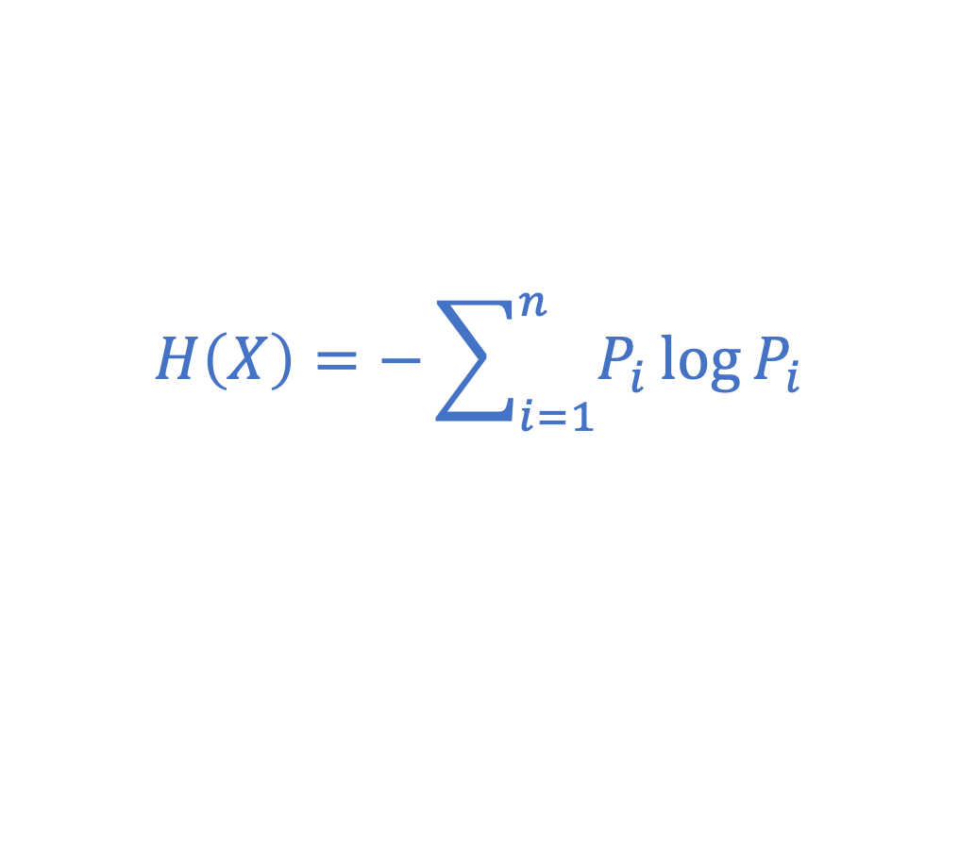
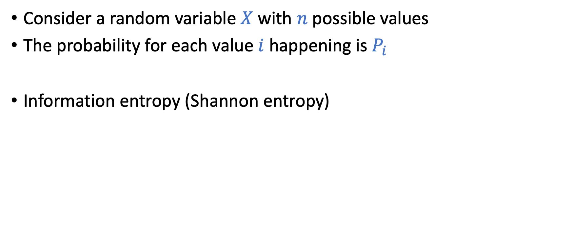
Entropy (Information Entropy)
Consider a random variable $X$ with $n$ possible values
The probability for each value $i$ happening is $P_{i}$
Information entropy (Shannon entropy)
$$H\left(X\right)=−\sum_{i=1}^{n}{P_{i}\log{P_{i}}}$$
What are the interpretations of entropy?
Higher entropy => More uncertainty => Higher unpredictability

Slide 14
Principle of Maximum Entropy
“the probability distribution which best represents the current state of knowledge is the one with largest entropy”
Consider a dice with 6 faces
Without any knowledge, what’s your best bet on the probability of 1~6 happening
Assume you are told the probability of 3 happening is ½, what’s your best bet on the probability of the rest numbers happening?

Slide 15
How does this apply to label aggregation?
We are trying to infer
true task labels
worker skills
and maybe other parameters
Principle of Maximum Entropy
Worker skills are often modeled as “probability distributions”
Given observed labels, we can infer worker skills that “maximize entropy”
We can then infer labels that minimizes uncertainty

Slide 16
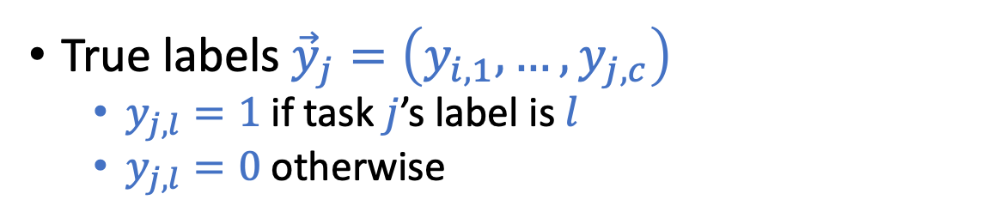
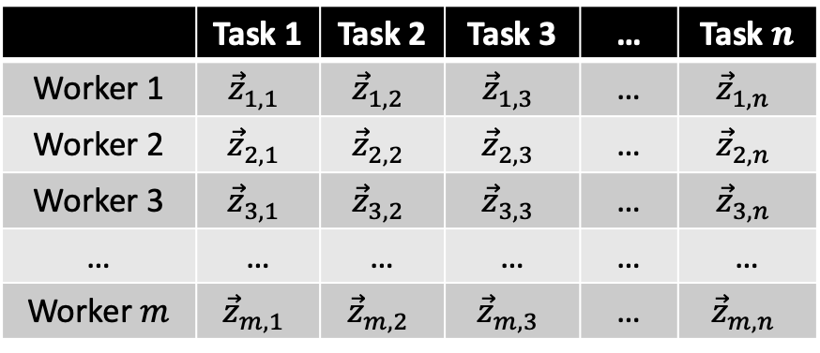
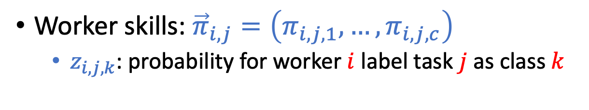
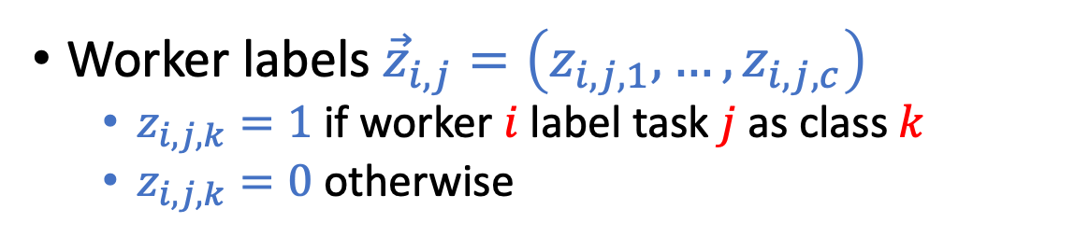
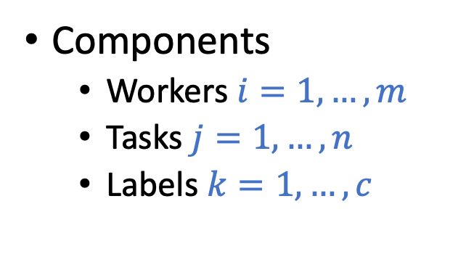
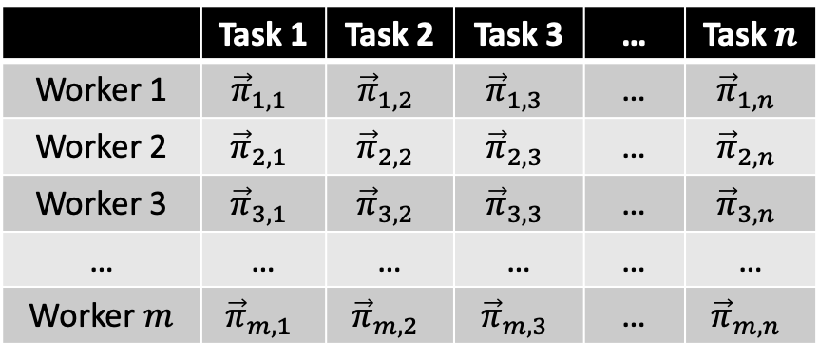

Setting
Goal: Given $\vec{z}$, how to infer $\vec{π}$ and $\vec{y}$ ?
Observations
Underlying distribution
 | Task 1 | Task 2 | Task 3 | … | Task $n$
Worker 1 | $${\vec{z}}_{1,1}$$ | $${\vec{z}}_{1,2}$$ | $${\vec{z}}_{1,3}$$ | … | $${\vec{z}}_{1,n}$$
Worker 2 | $${\vec{z}}_{2,1}$$ | $${\vec{z}}_{2,2}$$ | $${\vec{z}}_{2,3}$$ | … | $${\vec{z}}_{2,n}$$
Worker 3 | $${\vec{z}}_{3,1}$$ | $${\vec{z}}_{3,2}$$ | $${\vec{z}}_{3,3}$$ | … | $${\vec{z}}_{3,n}$$
… | … | … | … | … | …
Worker $m$ | $${\vec{z}}_{m,1}$$ | $${\vec{z}}_{m,2}$$ | $${\vec{z}}_{m,3}$$ | … | $${\vec{z}}_{m,n}$$
 | Task 1 | Task 2 | Task 3 | … | Task $n$
Worker 1 | $${\vec{π}}_{1,1}$$ | $${\vec{π}}_{1,2}$$ | $${\vec{π}}_{1,3}$$ | … | $${\vec{π}}_{1,n}$$
Worker 2 | $${\vec{π}}_{2,1}$$ | $${\vec{π}}_{2,2}$$ | $${\vec{π}}_{2,3}$$ | … | $${\vec{π}}_{2,n}$$
Worker 3 | $${\vec{π}}_{3,1}$$ | $${\vec{π}}_{3,2}$$ | $${\vec{π}}_{3,3}$$ | … | $${\vec{π}}_{3,n}$$
… | … | … | … | … | …
Worker $m$ | $${\vec{π}}_{m,1}$$ | $${\vec{π}}_{m,2}$$ | $${\vec{π}}_{m,3}$$ | … | $${\vec{π}}_{m,n}$$
Components
Workers $i=1,…,m$
Tasks $j=1,…,n$
Labels $k=1,…,c$
Worker labels ${\vec{z}}_{i,j}=\left(z_{i,j,1},…,z_{i,j,c}\right)$
$z_{i,j,k}=1$ if worker $i$ label task $j$ as class $k$
$z_{i,j,k}=0$ otherwise
True labels ${\vec{y}}_{j}=\left(y_{i,1},…,y_{j,c}\right)$
$y_{j,l}=1$ if task $j$’s label is $l$
$y_{j,l}=0$ otherwise
Worker skills: ${\vec{π}}_{i,j}=\left(π_{i,j,1},…,π_{i,j,c}\right)$
$z_{i,j,k}$: probability for worker $i$ label task $j$ as class $k$

Slide 17
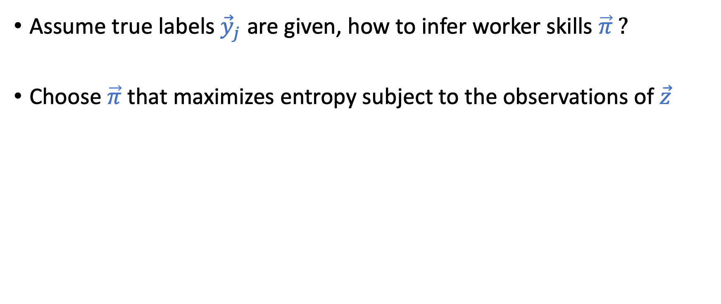
Apply the Maximum Entropy Principle
Assume true labels ${\vec{y}}_{j}$ are given, how to infer worker skills $\vec{π} ?$
Choose $\vec{π}$ that maximizes entropy subject to the observations of $\vec{z}$

Slide 18

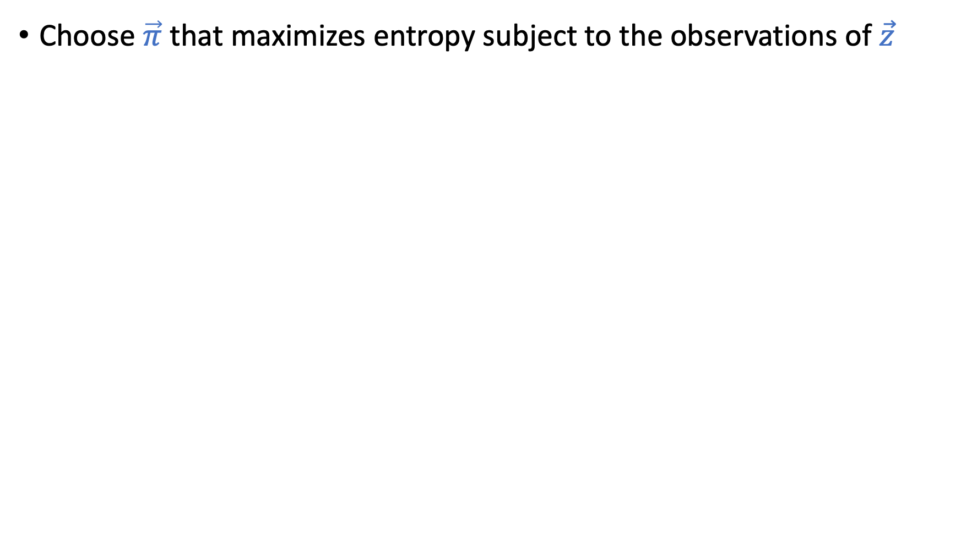

Choose $\vec{π}$ that maximizes entropy subject to the observations of $\vec{z}$
Entropy
Probability constraints
 | Task 1 | Task 2 | Task 3 | … | Task $n$
Worker 1 | $${\vec{z}}_{1,1}$$ | $${\vec{z}}_{1,2}$$ | $${\vec{z}}_{1,3}$$ | … | $${\vec{z}}_{1,n}$$
Worker 2 | $${\vec{z}}_{2,1}$$ | $${\vec{z}}_{2,2}$$ | $${\vec{z}}_{2,3}$$ | … | $${\vec{z}}_{2,n}$$
Worker 3 | $${\vec{z}}_{3,1}$$ | $${\vec{z}}_{3,2}$$ | $${\vec{z}}_{3,3}$$ | … | $${\vec{z}}_{3,n}$$
… | … | … | … | … | …
Worker $m$ | $${\vec{z}}_{m,1}$$ | $${\vec{z}}_{m,2}$$ | $${\vec{z}}_{m,3}$$ | … | $${\vec{z}}_{m,n}$$
 | Task 1 | Task 2 | Task 3 | … | Task $n$
Worker 1 | $${\vec{π}}_{1,1}$$ | $${\vec{π}}_{1,2}$$ | $${\vec{π}}_{1,3}$$ | … | $${\vec{π}}_{1,n}$$
Worker 2 | $${\vec{π}}_{2,1}$$ | $${\vec{π}}_{2,2}$$ | $${\vec{π}}_{2,3}$$ | … | $${\vec{π}}_{2,n}$$
Worker 3 | $${\vec{π}}_{3,1}$$ | $${\vec{π}}_{3,2}$$ | $${\vec{π}}_{3,3}$$ | … | $${\vec{π}}_{3,n}$$
… | … | … | … | … | …
Worker $m$ | $${\vec{π}}_{m,1}$$ | $${\vec{π}}_{m,2}$$ | $${\vec{π}}_{m,3}$$ | … | $${\vec{π}}_{m,n}$$

Slide 19
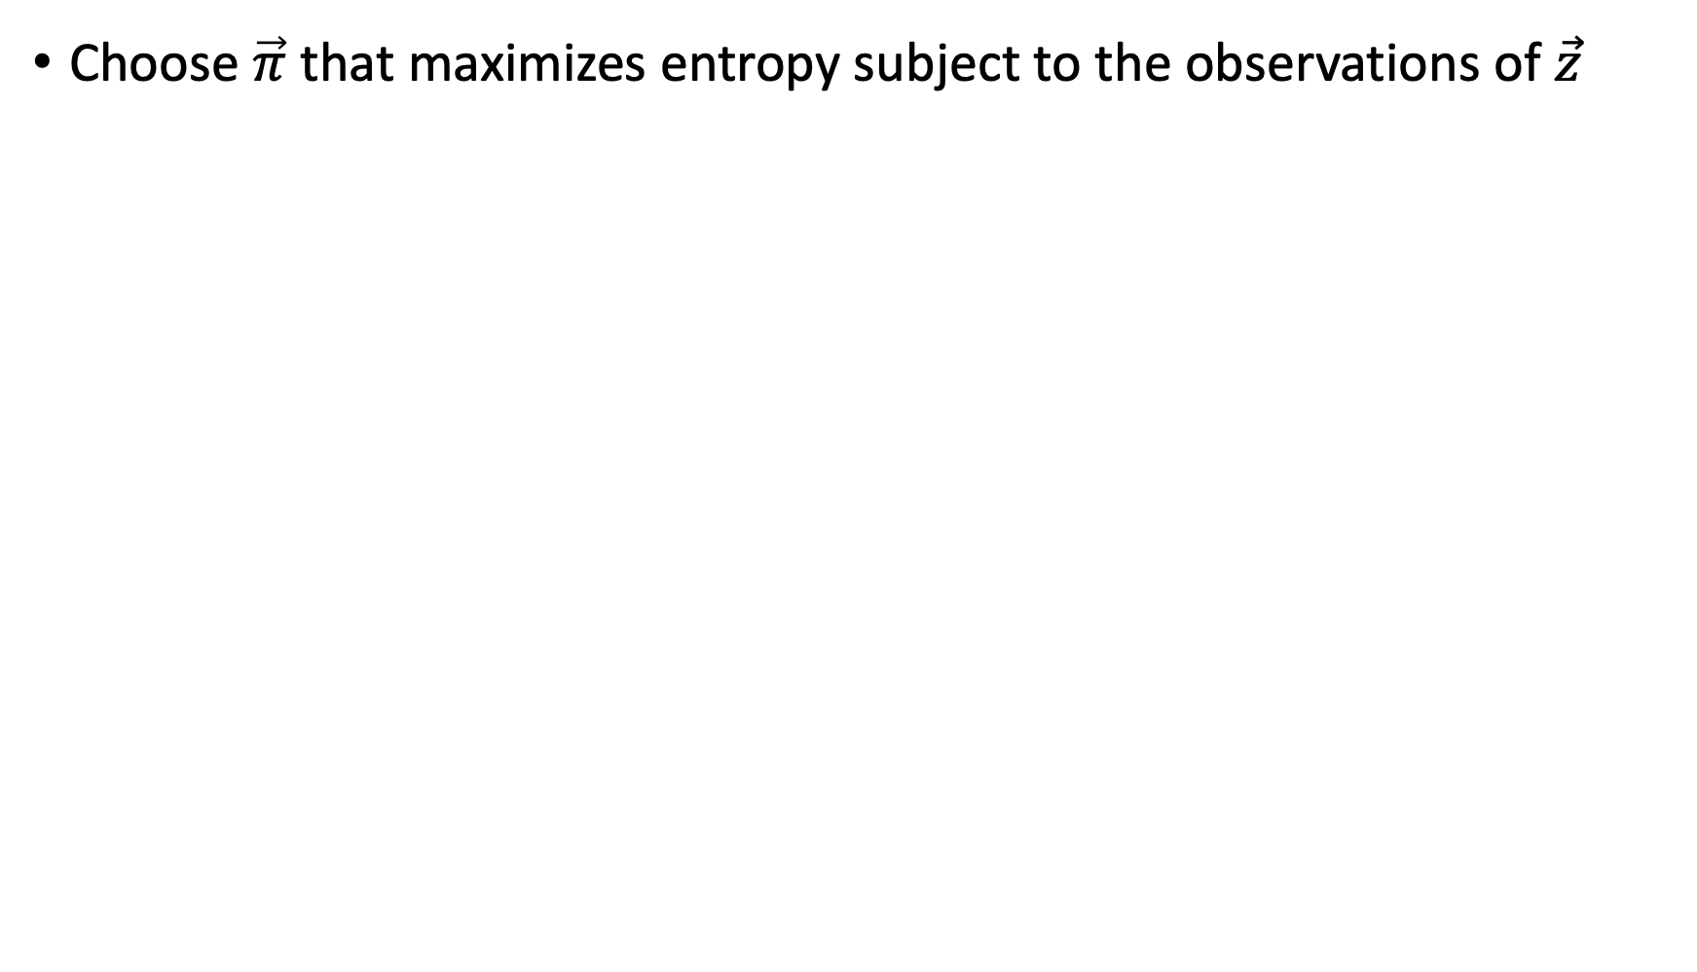
Choose $\vec{π}$ that maximizes entropy subject to the observations of $\vec{z}$
“expected # labels in each class = empirical # labels
(We can relax them to “approximately equal”)
 | Task 1 | Task 2 | Task 3 | … | Task $n$
Worker 1 | $${\vec{z}}_{1,1}$$ | $${\vec{z}}_{1,2}$$ | $${\vec{z}}_{1,3}$$ | … | $${\vec{z}}_{1,n}$$
Worker 2 | $${\vec{z}}_{2,1}$$ | $${\vec{z}}_{2,2}$$ | $${\vec{z}}_{2,3}$$ | … | $${\vec{z}}_{2,n}$$
Worker 3 | $${\vec{z}}_{3,1}$$ | $${\vec{z}}_{3,2}$$ | $${\vec{z}}_{3,3}$$ | … | $${\vec{z}}_{3,n}$$
… | … | … | … | … | …
Worker $m$ | $${\vec{z}}_{m,1}$$ | $${\vec{z}}_{m,2}$$ | $${\vec{z}}_{m,3}$$ | … | $${\vec{z}}_{m,n}$$
 | Task 1 | Task 2 | Task 3 | … | Task $n$
Worker 1 | $${\vec{π}}_{1,1}$$ | $${\vec{π}}_{1,2}$$ | $${\vec{π}}_{1,3}$$ | … | $${\vec{π}}_{1,n}$$
Worker 2 | $${\vec{π}}_{2,1}$$ | $${\vec{π}}_{2,2}$$ | $${\vec{π}}_{2,3}$$ | … | $${\vec{π}}_{2,n}$$
Worker 3 | $${\vec{π}}_{3,1}$$ | $${\vec{π}}_{3,2}$$ | $${\vec{π}}_{3,3}$$ | … | $${\vec{π}}_{3,n}$$
… | … | … | … | … | …
Worker $m$ | $${\vec{π}}_{m,1}$$ | $${\vec{π}}_{m,2}$$ | $${\vec{π}}_{m,3}$$ | … | $${\vec{π}}_{m,n}$$

Slide 20
Choose $\vec{π}$ that maximizes entropy subject to the observations of $\vec{z}$
Consistency constraints
 | Task 1 | Task 2 | Task 3 | … | Task $n$
Worker 1 | $${\vec{z}}_{1,1}$$ | $${\vec{z}}_{1,2}$$ | $${\vec{z}}_{1,3}$$ | … | $${\vec{z}}_{1,n}$$
Worker 2 | $${\vec{z}}_{2,1}$$ | $${\vec{z}}_{2,2}$$ | $${\vec{z}}_{2,3}$$ | … | $${\vec{z}}_{2,n}$$
Worker 3 | $${\vec{z}}_{3,1}$$ | $${\vec{z}}_{3,2}$$ | $${\vec{z}}_{3,3}$$ | … | $${\vec{z}}_{3,n}$$
… | … | … | … | … | …
Worker $m$ | $${\vec{z}}_{m,1}$$ | $${\vec{z}}_{m,2}$$ | $${\vec{z}}_{m,3}$$ | … | $${\vec{z}}_{m,n}$$
 | Task 1 | Task 2 | Task 3 | … | Task $n$
Worker 1 | $${\vec{π}}_{1,1}$$ | $${\vec{π}}_{1,2}$$ | $${\vec{π}}_{1,3}$$ | … | $${\vec{π}}_{1,n}$$
Worker 2 | $${\vec{π}}_{2,1}$$ | $${\vec{π}}_{2,2}$$ | $${\vec{π}}_{2,3}$$ | … | $${\vec{π}}_{2,n}$$
Worker 3 | $${\vec{π}}_{3,1}$$ | $${\vec{π}}_{3,2}$$ | $${\vec{π}}_{3,3}$$ | … | $${\vec{π}}_{3,n}$$
… | … | … | … | … | …
Worker $m$ | $${\vec{π}}_{m,1}$$ | $${\vec{π}}_{m,2}$$ | $${\vec{π}}_{m,3}$$ | … | $${\vec{π}}_{m,n}$$

Slide 21
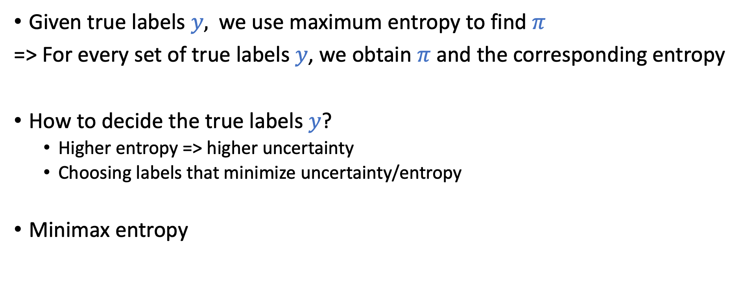
Solving the Optimization
Given true labels $y,$ we use maximum entropy to find $π$
=> For every set of true labels $y$, we obtain $π$ and the corresponding entropy
How to decide the true labels $y$?
Higher entropy => higher uncertainty
Choosing labels that minimize uncertainty/entropy
Minimax entropy

Slide 22
An interesting way of looking at label aggregation
Finding the labels/distribution with minimax entropy
Can we incorporate models of label generation?
e.g., Tasks are homogeneous
e.g., Tasks have different difficulty levels
Express them as additional constraints

Slide 23
Additional Details on the Technical Insights
Perform reasonably well in practice
The dual formulation gives nice insights
One set of dual variables represent worker skills
Another set of dual variable represent task difficulties

Slide 24
A Recap on Label Aggregation

Slide 25
The Approaches We Covered
EM-Based methods (The mainstream approach)
Develop models of label generation
Write down the likelihood function
Using EM algorithms to optimize likelihood
Matrix-based method
Perform SVD, using the top left singular vector as the prediction
Others
Minimax entropy
And more…

Slide 26
General Discussion on Label Aggregation
Common assumption: each label is i.i.d. drawn from some distribution
This assumption enables tons of papers applying statistics/learning techniques in crowdsourcing (low-hanging fruit)
Discussion
What other assumptions have been made in the papers you read?
Under what scenarios do you think this (and/or other assumptions) is reasonable?
Is there any assumption you think we should try to relax in this line of research.
If you need to keep working on label aggregation, what would you propose to do?

Slide 27
Concerns on Human as Data Sources

Slide 28
Machine Learning Lifecycle
Feedback
Task Definition
Deployment
Dataset Construction
Testing
Model Definition
Training

Slide 29
Machine Learning Lifecycle
Feedback
Task Definition
Deployment
Dataset Construction
Most ML research
Testing
Model Definition
Training

Slide 30
Machine Learning Lifecycle
Feedback
Task Definition
What we have covered so far
Deployment
Dataset Construction
Most ML research
Testing
Model Definition
Training

Slide 31
Assumption of (Supervise) Machine Learning
Training data and testing data are independently drawn from the same distribution.
We can learn the correlation in the training data and utilize it to make predictions on the testing data.
In practice, training data is often annotated/generated by humans.

Slide 32
Task: Acquire Image Labels [Otterbacher et al. 2019]
Label distributions are different for images of different gender/race
Female images receive more labels related to the “attractiveness”.

Slide 33
Microsoft Release a Twitter Chatbot in 2016

Slide 34
Microsoft Release a Twitter Chatbot in 2016

Slide 35
More Examples

Slide 36
More Examples

Slide 37
Stereotype Mirroring and Exaggeration
Is this result mirroring the real statistics or an exaggeration?
Assume this is mirroring of the real statistics, are there other concerns?
Are we reinforcing the stereotypes?
Are we being “unfair” to disadvantage groups that are mistreated in the past?
Unequal Representation and Gender Stereotypes in Image Search Results for Occupations. Kay et al. CHI 2015.

Slide 38
Consequences of Biases

Slide 39
Can we just model the bias and de-bias it afterwards?
Not always possible even with perfect knowledge, especially when there are feedback loops.

Slide 40
Bandit Learning with Biased Feedback
Wei Tang and Chien-Ju Ho
In AAMAS 2019

Slide 41

User Generated Content Platforms

Slide 42
Users’ Feedback Might Be Biased
Herding Effect
In a Reddit-like platform, randomly insert an upvote/downvote to some posts right after they are posted.
Social Influence Bias: A Randomized Experiment. Muchnik et al. Science 2013.

Slide 43
Main Results
Explore two general set of bias models
Model 1: feedback is biased by empirical average
It’s possible to separate the bias with enough data.
Model 2: feedback is biased by the whole history
Impossible to separate the bias even with infinite data.
Debiasing from data might not be feasible.
Should obtain “good” data in the first place (what is “good” data?)

Slide 44
Obtaining Good Data – Filtering and Balancing Dataset
Attempt to address fairness by “adjusting” training datasets
Remove “offensive” labels
Remove “non-imageable” labels
Balance the distribution
This is a hard question; even defining what is “good” is hard

Slide 45
Discussions
Thoughts about the paper.
There are many trade-offs we need to make when trying to make the datasets “fairer”. Think about and discuss these trade-offs.
What are the other biases that could exist in crowdsourced datasets? What are the bad consequences?
What are the other possible approaches to make the datasets fairer?

Slide 46
Addressing Biases and Fairness
It’s a very hard question
In fact, it is mathematically “impossible” to solve perfectly. [See Kleinberg et al. 2017 in our “Fairness in AI”Lecture]
Require discussion between different stakeholders and people from different disciplines

Slide 47
Addressing Biases and Fairness
An emerging trend to integrate AI/ML with humans/society.
WashU Division of Computational and Data Sciences
A PhD program hosted by CSE, Political Science, Social Work, Psychology and Brain Science
MIT Institute for Data, Systems, and Society
CMU Societal Computing
Stanford Institute for Human-Centered Artificial Intelligence
USC Center for AI in Society
AAAI/ACM Conference on AI, Ethics, and Society
ACM FAccT (Fairness, Accountability, and Transparency)

Slide 48
Addressing Biases and Fairness
We will cover some recent research efforts
Discuss the fairness of algorithm outcomes
Nov 3: Fairness in AI
Nov 8: Human Perceptions of Fairness
“Crowdsource” the decisions that involve ethical concerns
Nov 10: Ethical decision making and participatory design

Slide 49
Seeing things from the other side
Heads up on the next paper
The paper has a very different flavor
Hopefully, you should see insights that are relevant to your own experience as a (short-term) crowd worker

